Slide 1
Subnational tailoring of malaria interventions and strategies
São Tomé e Principe
October 2023
Strategic Information and Response Unit
Global Malaria Program

Slide 2
Status of Analysis
Data collection – Finished
Data management – Ongoing, feedback from PNCM required
Stratification – Pending
Targeting Interventions – Pending

Slide 3
Data Collection
Data | Unit | Time range | Disaggregation
Population | District | 2018 - 2023 | Five years as age group, sex
Population-adm3 | Locality | 2012 - 2023 | Sex
Routine data | Health Facilities | 2018 – 2021 | <5, >5, Pregnant
Foci classification | Locality | 2018 – 2022 | 365 adm3
Passive case detection | Individual | 2022 | Case level
Reactive case detection | Individual | 2022 | Case level
Demographic and Epidemiological data
Population
Monthly aggregated routine data
Case-level data from passive and reactive surveillance systems
Foci classification

Slide 4
Data Collection
Data | Unit | Time range | Disaggregation
Routine Interventions | Health Facilities | 2018 – 2022 | Monthly
IRS | Localities | 2019 – 2022
ITNs Mass Campaign | Province | 2022
LSM | Localities | 2021
Vector abundance | District | 2018 - 2022 | Adult mosquito, Pupa
Insecticide resistance | District | 2018 – 2022
Malaria transmission determinants
Historical intervention implementation
Entomological information
Insecticide resistance

Slide 5
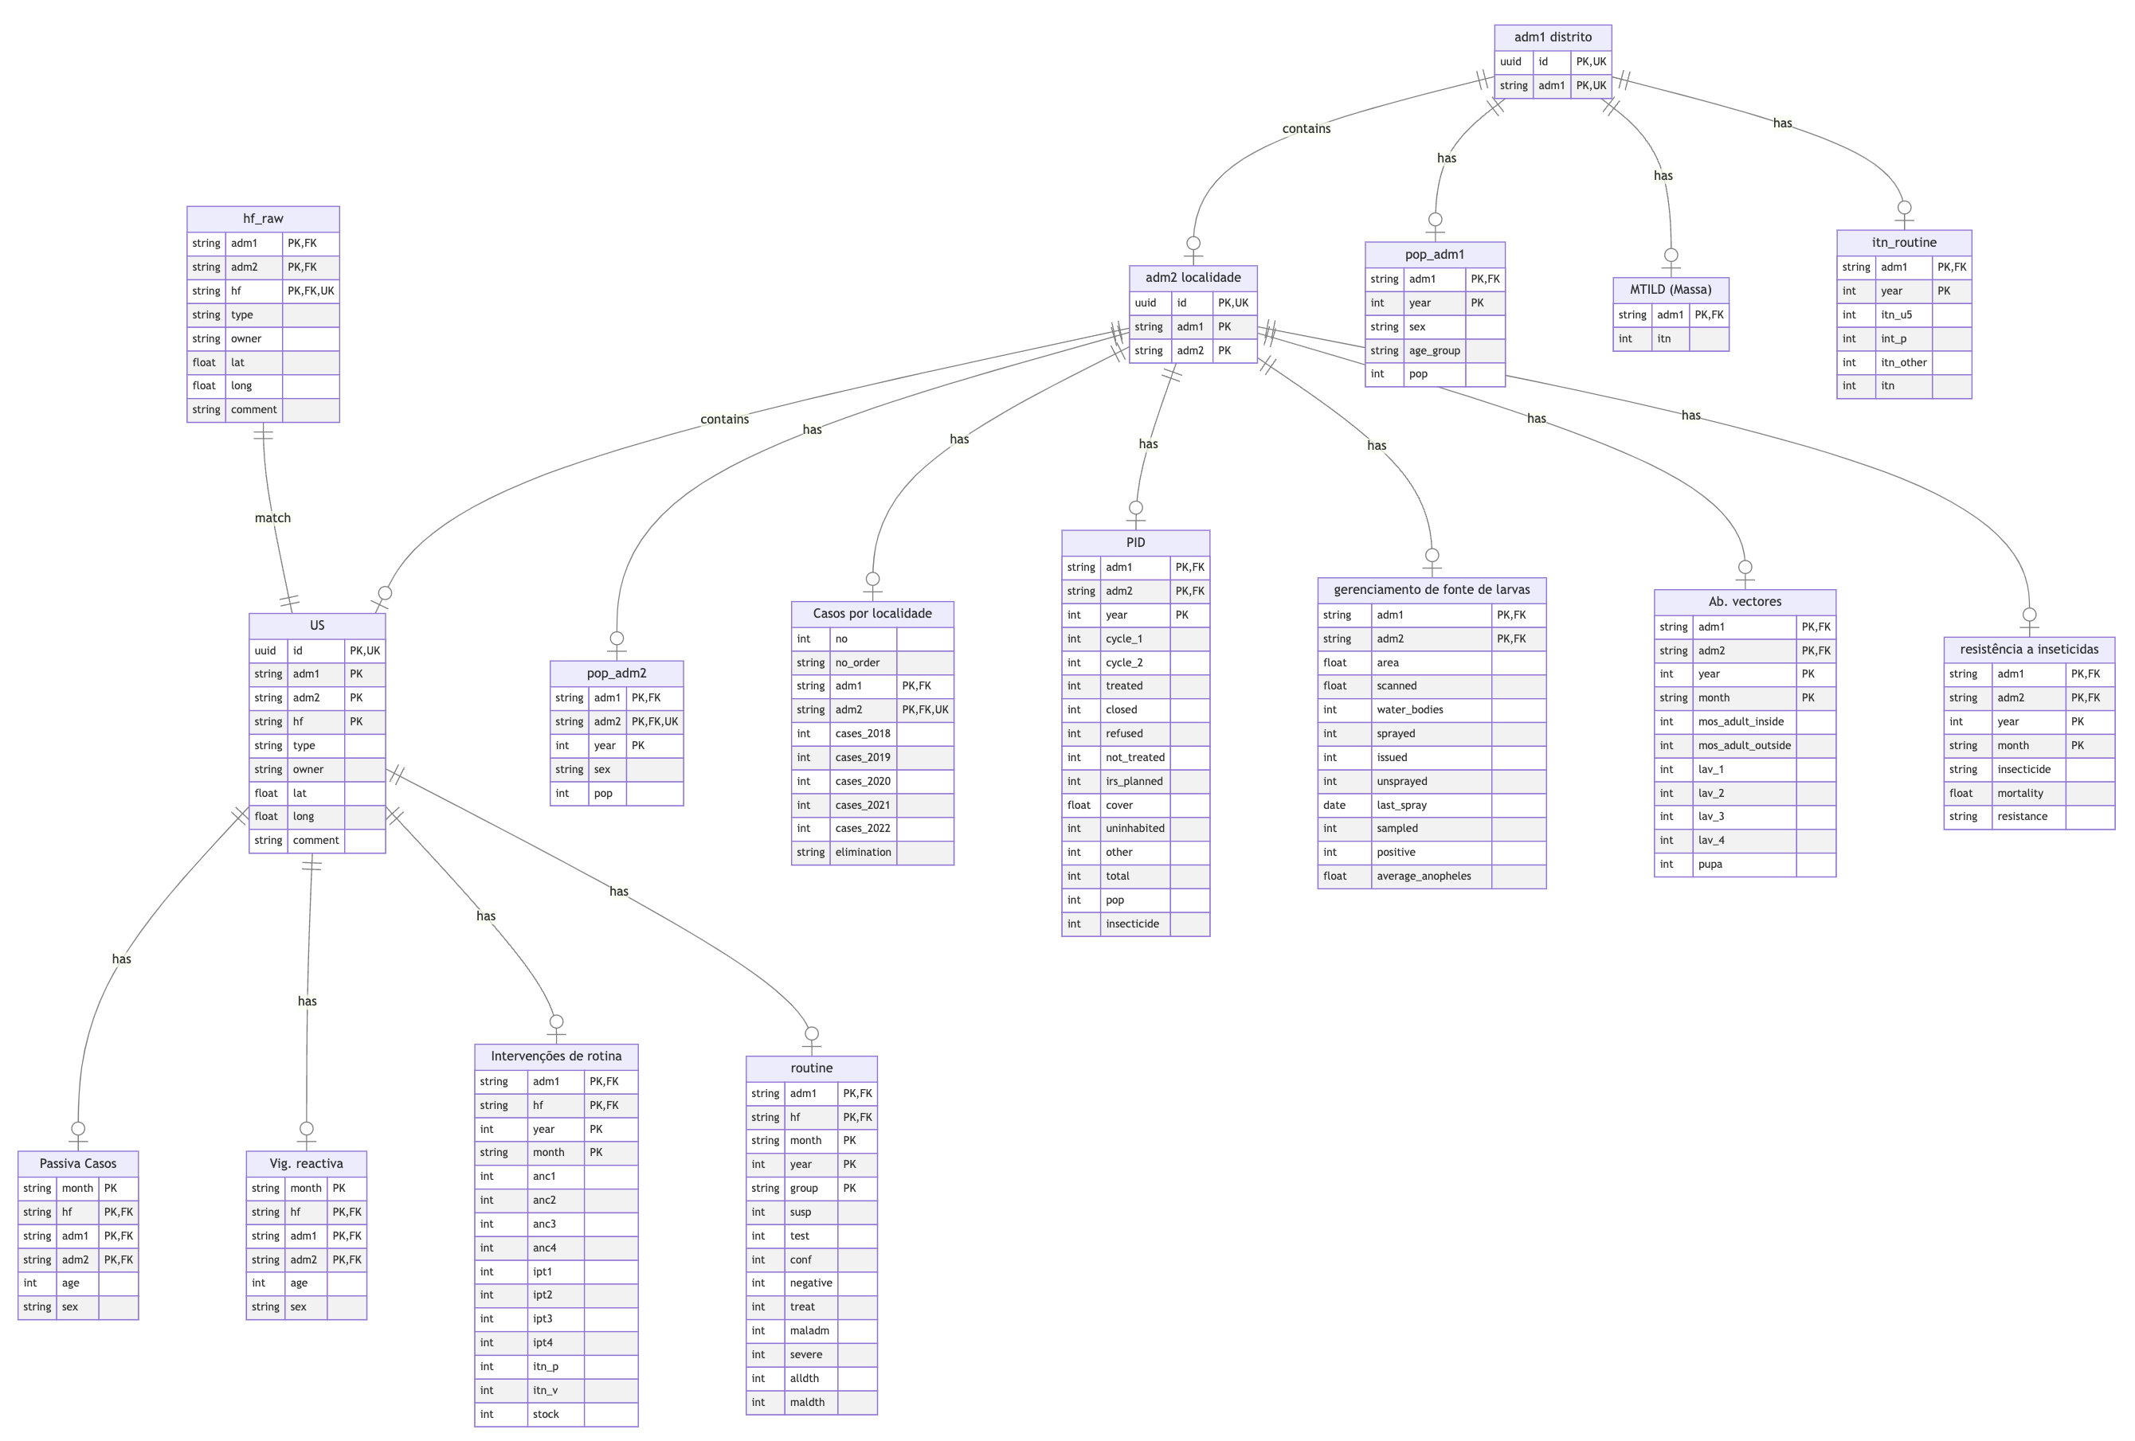
Data Structure

Slide 6
Data management
Administrative boundary map that represents the unit of analysis
Health facility catchment areas
Routine malaria data
Interventions
Other contextual factors

Slide 7
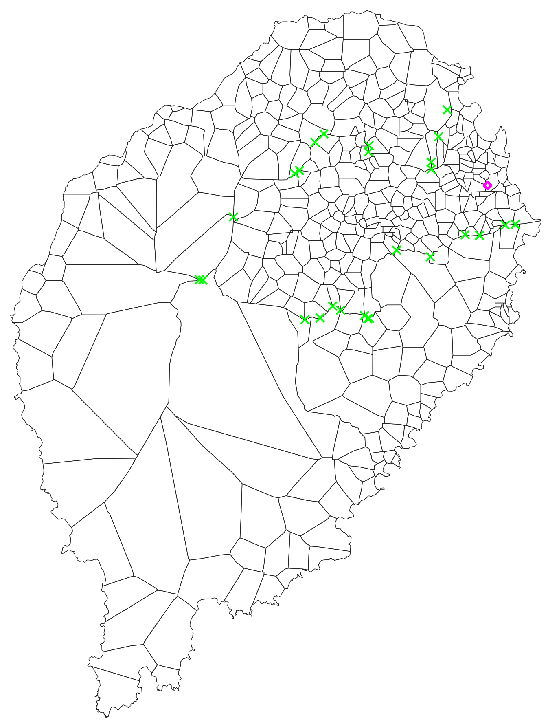
Fix shapefile

Slide 8
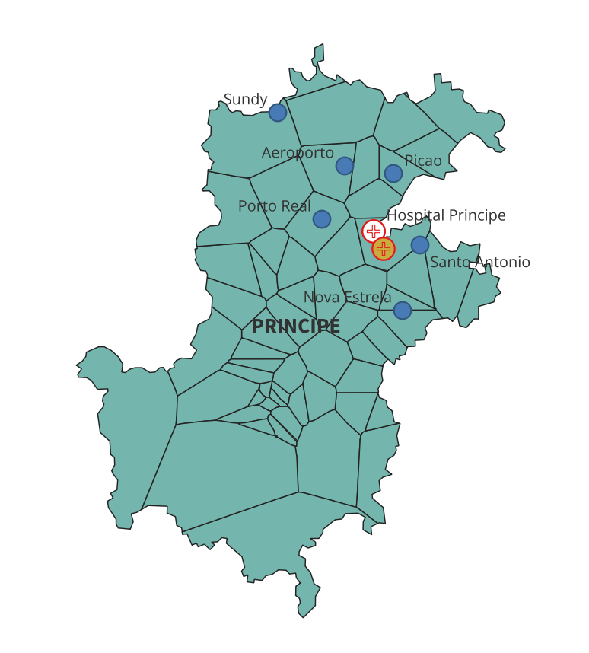
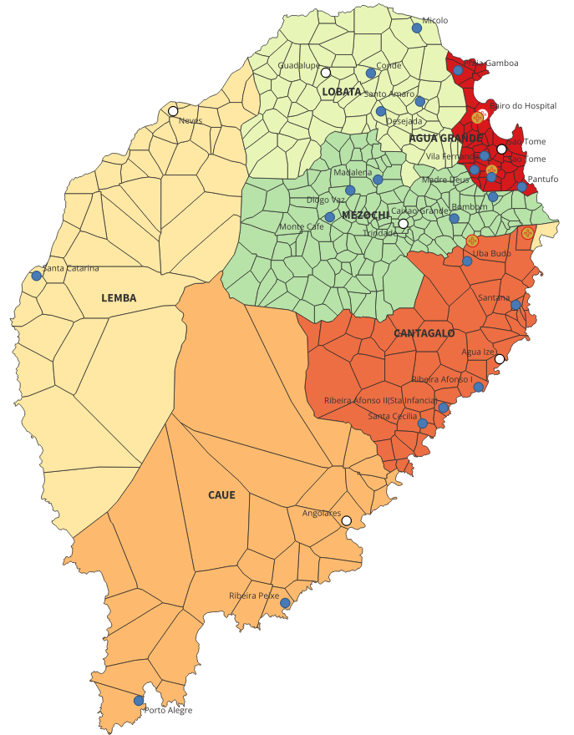
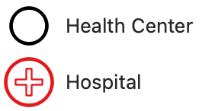

Administrative boundaries and distribution of Health Facilities
Unit of analysis: Localities
Provinces: 2
Districts: 7
an additional entry labeled "CNE" in the dataset, which may represent the National Center for Endemic Diseases (CNE) in Sao Tome and Principe.
Country need to confirm CNE
Localities: 485 localities in shapefile
Health facilities: 43
Hospitals: 2
Health Centers: 7
Health Posts: 28

Slide 9
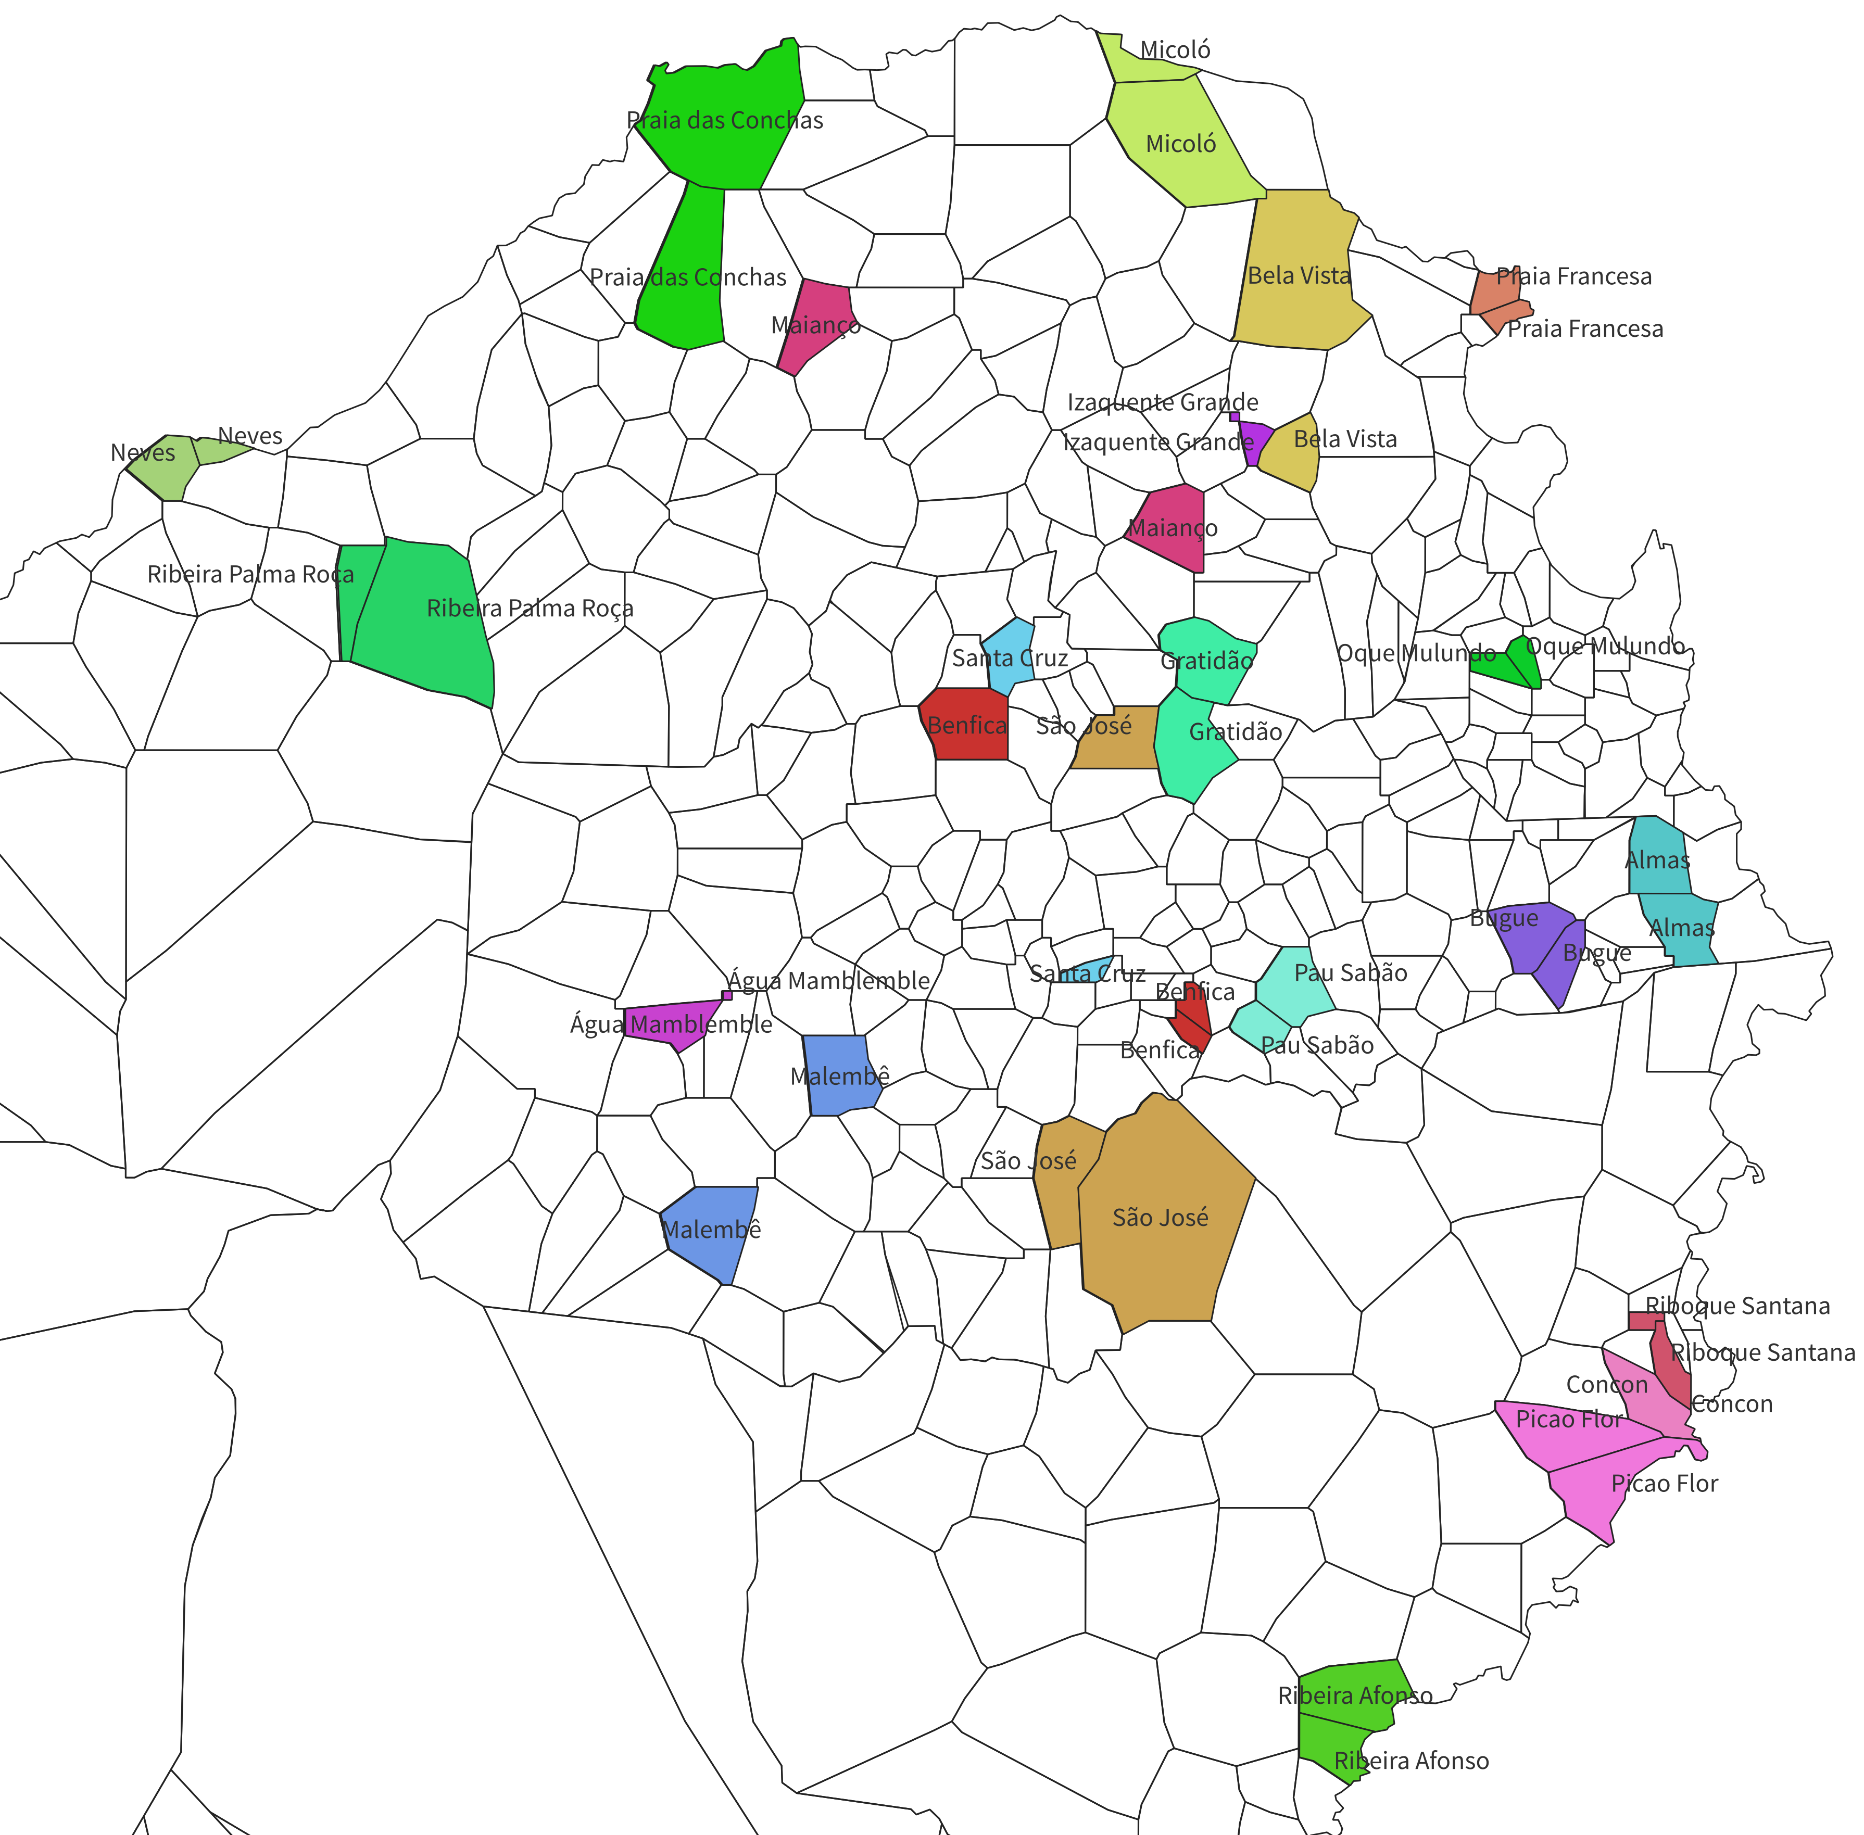
Administrative boundaries and distribution of Health Facilities
Duplicated Localities
There are 58 duplicated localities with the same district-locality combination in the shapefile (see map)
Some of them are adjacent to each other, but not always
Feedback required from PNCM:
WHO sends the list of duplicated localities
PNCM to confirm action to be taken regarding:
Adjacent Duplicates
Non-Adjacent Duplicates

Slide 10
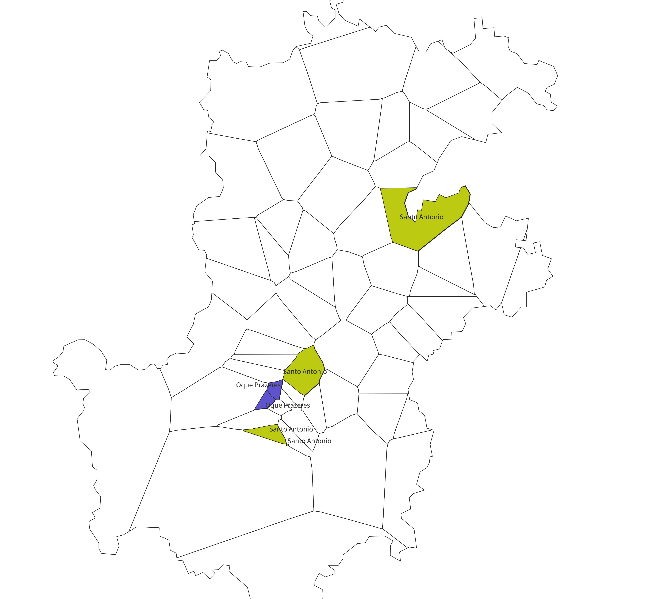
Administrative boundaries and distribution of Health Facilities
Duplicated Localities
There are 58 duplicated localities with the same district-locality combination in the shapefile (see map)
Some of them are adjacent to each other, but not always
Feedback required from PNCM:
WHO sends the list of duplicated localities
PNCM to confirm action to be taken regarding:
Adjacent Duplicates
Non-Adjacent Duplicates

Slide 11
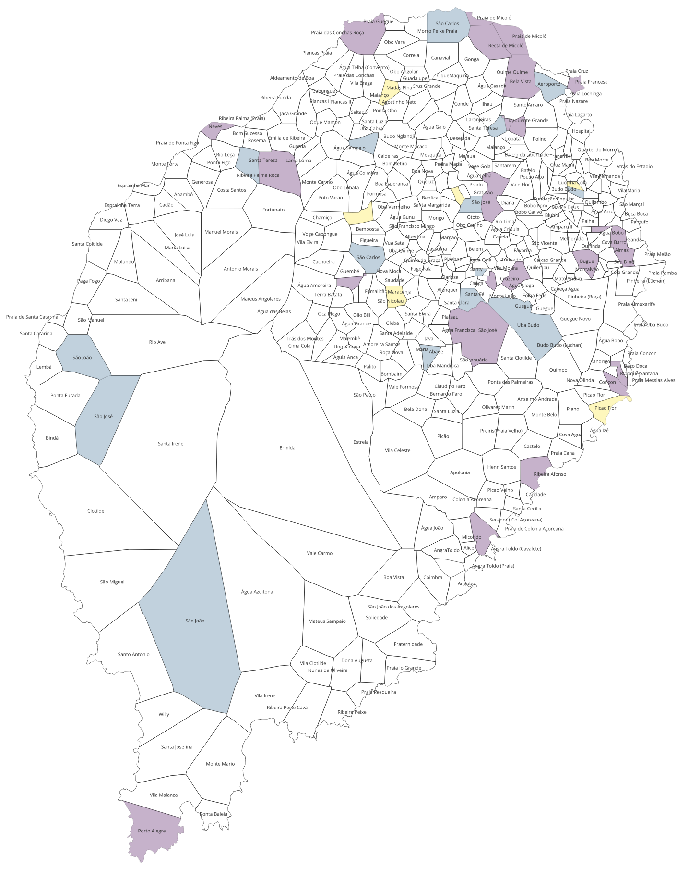
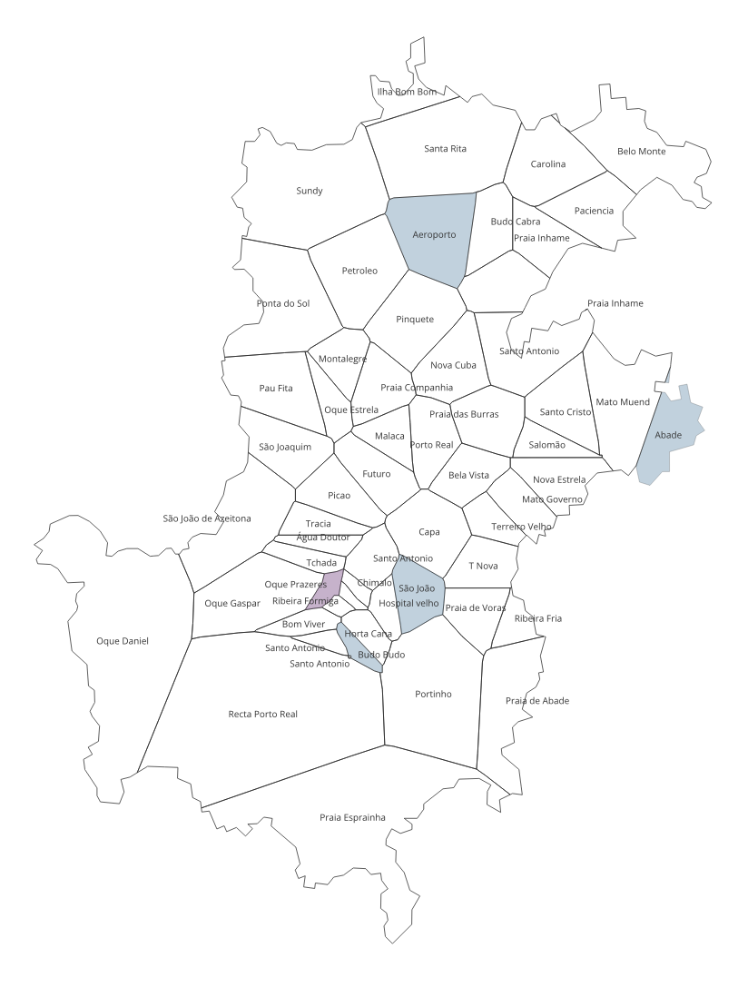
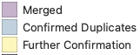
Shapefile data management
Worked together on 28th Oct
- Merged 20 pairs of duplicates
- Renamed 2 localities
- Confirmed 9 sets of suspected duplicates which required no more action
- 7 localities pending for confirmation (yellow)
Add district

Slide 12
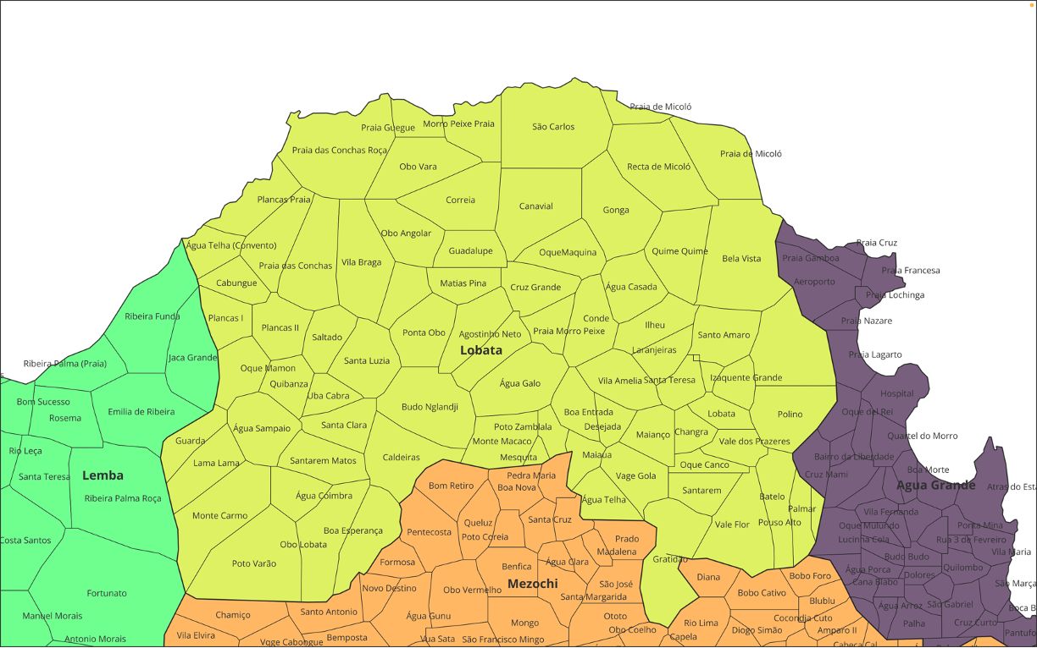

Slide 13
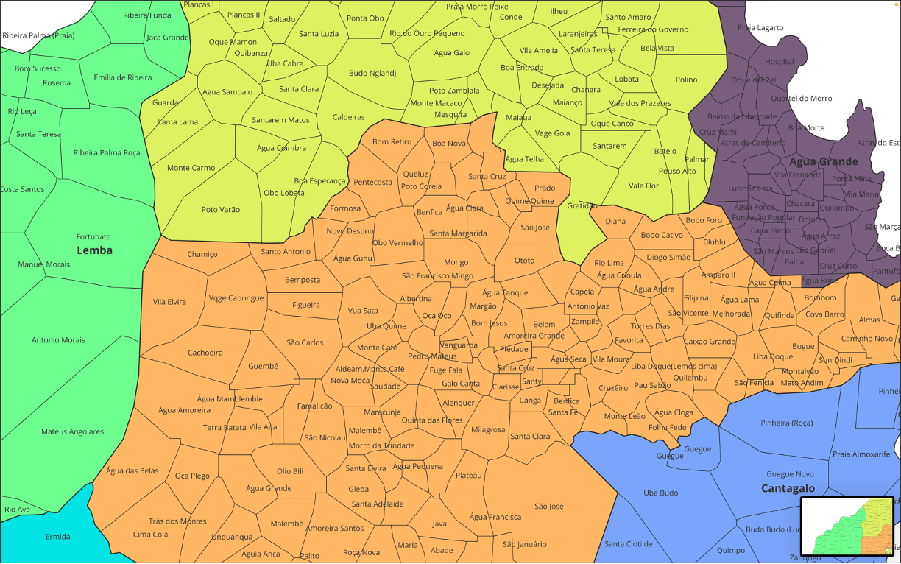

Slide 14
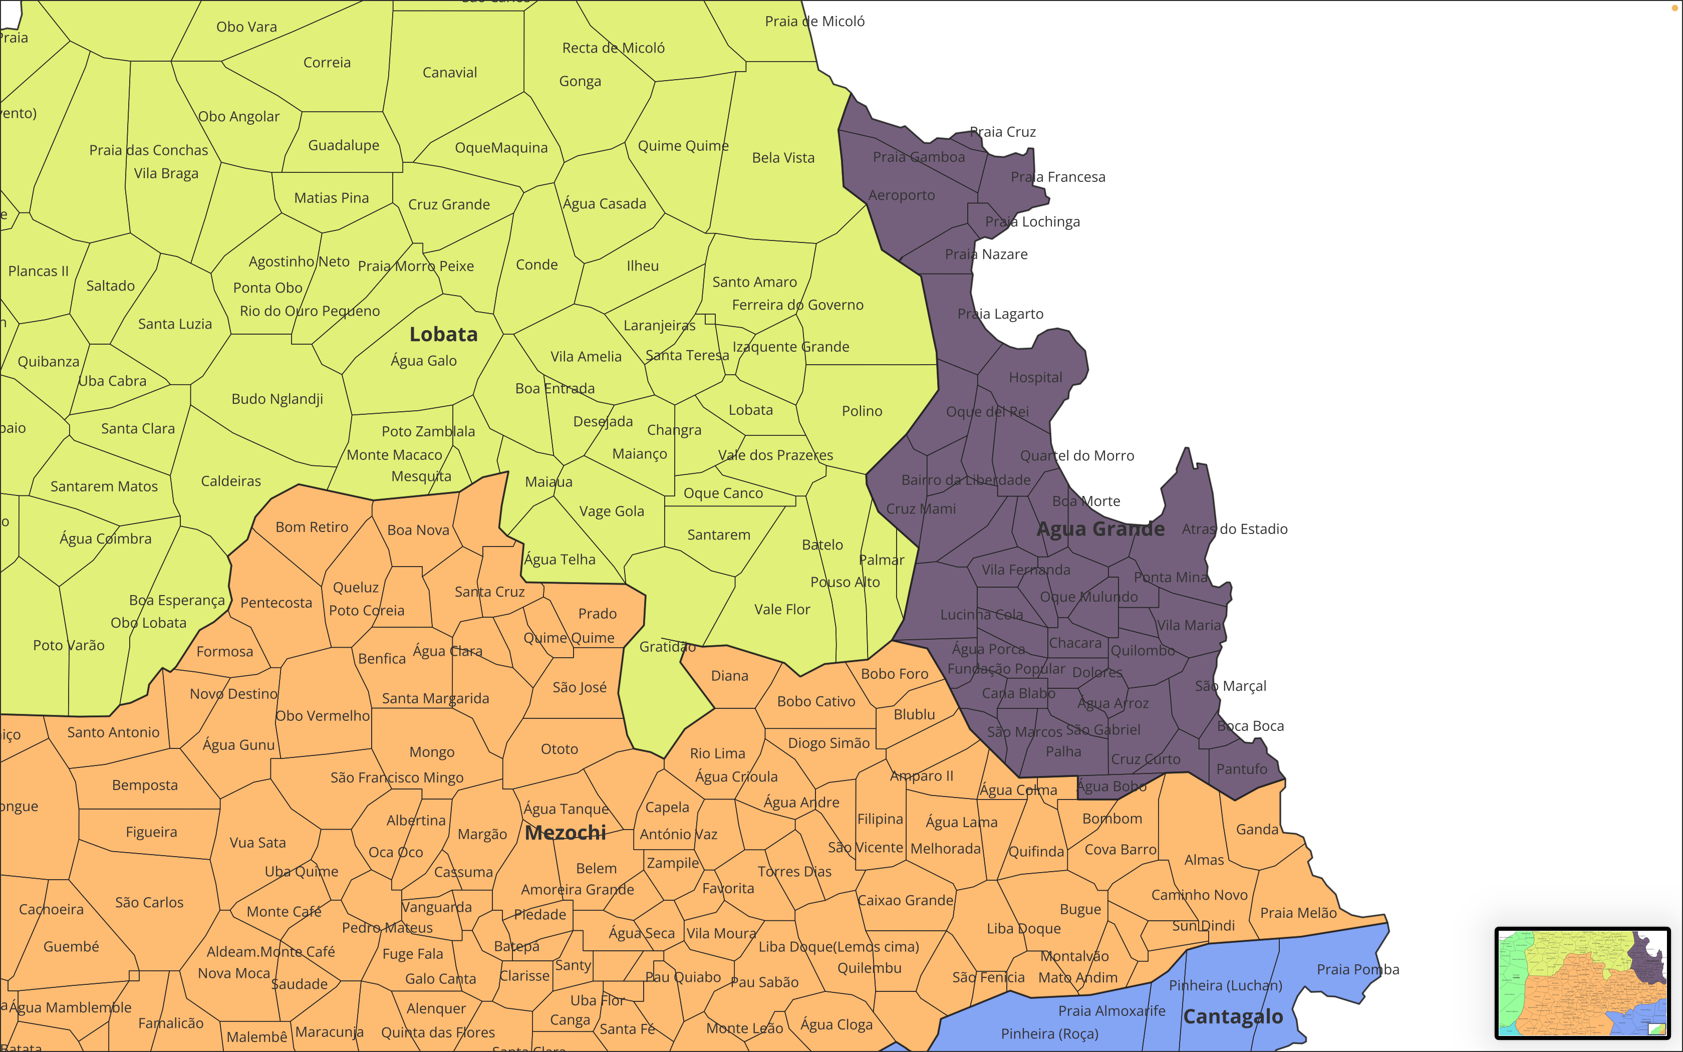

Slide 15
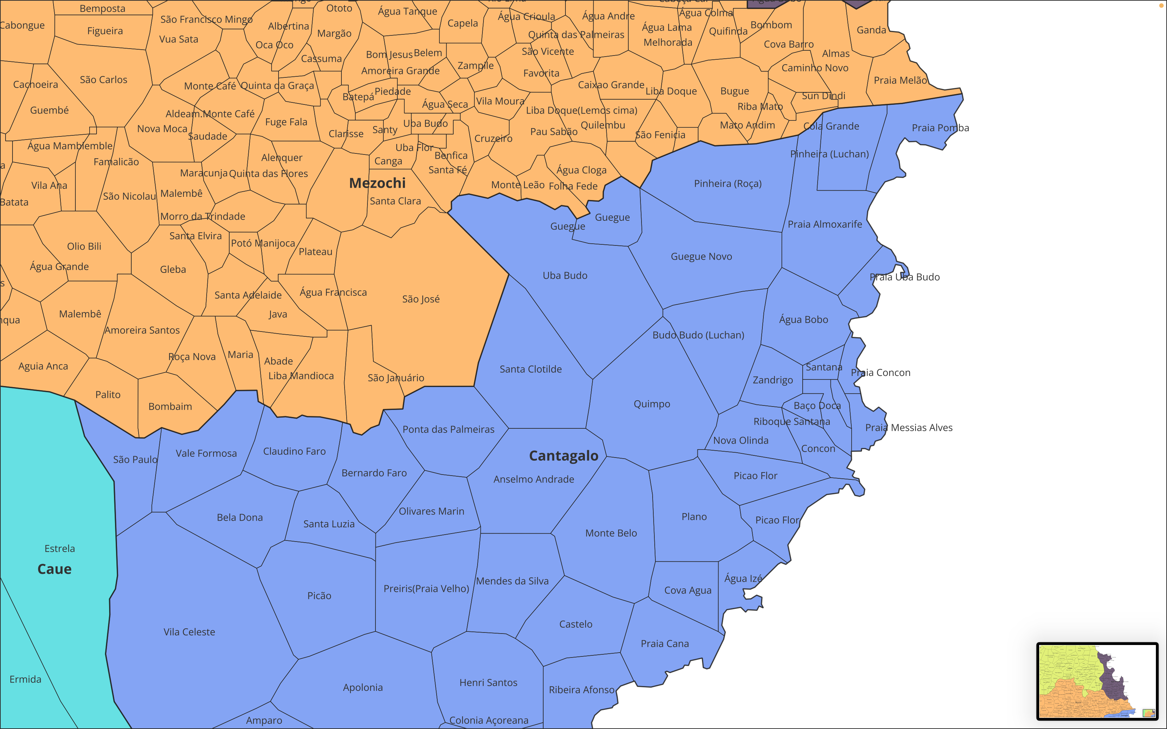

Slide 16
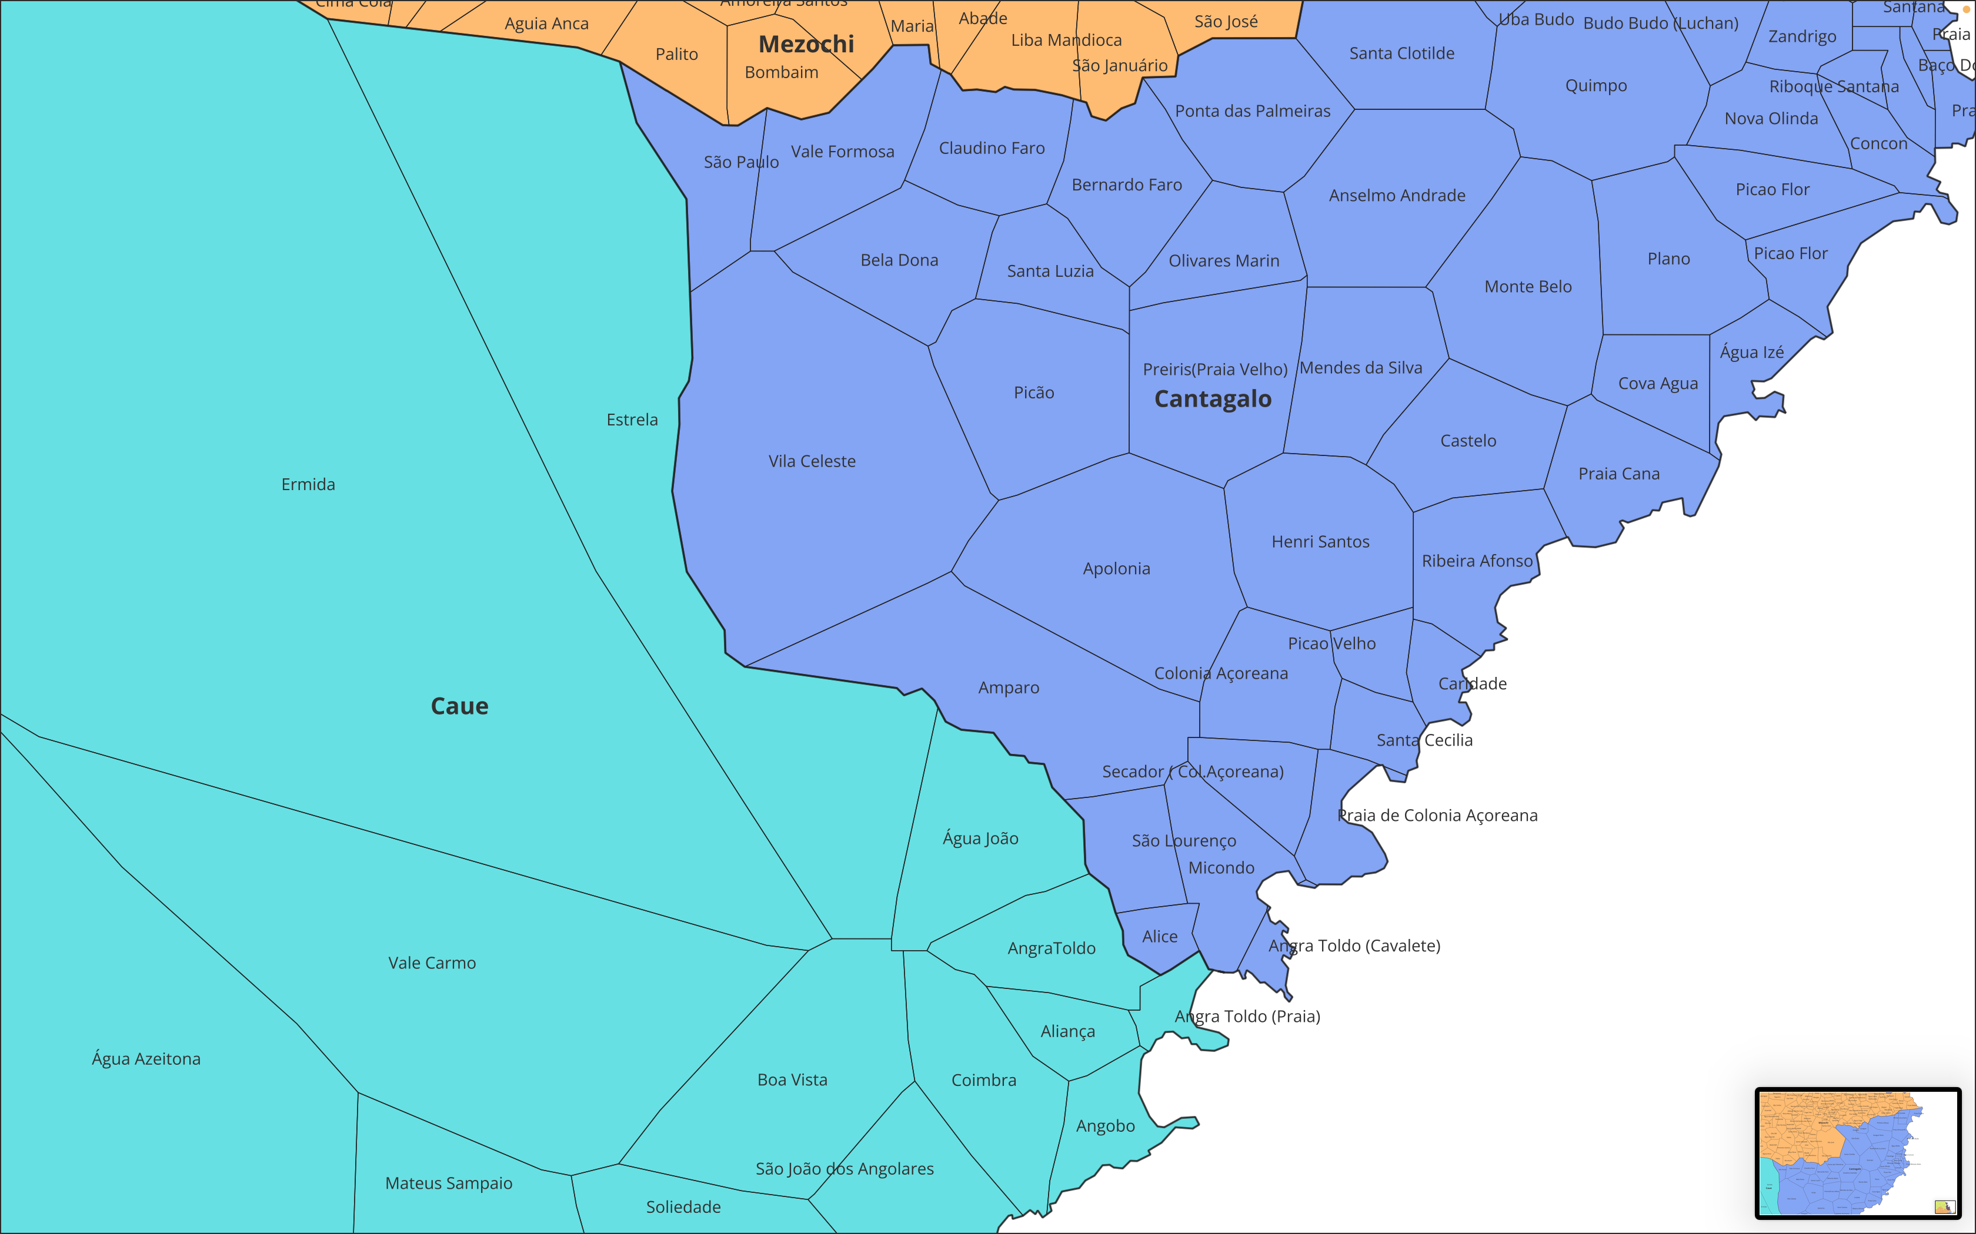

Slide 17
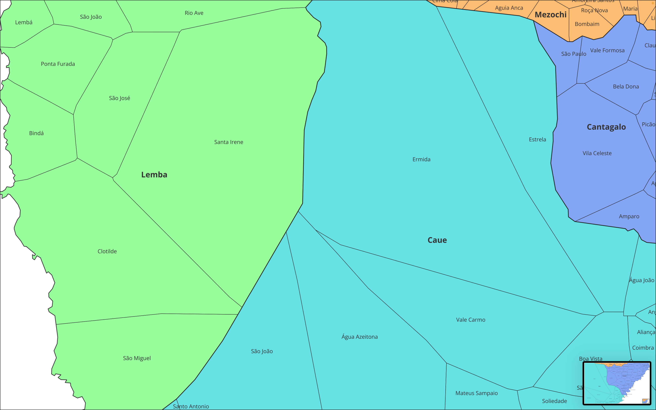

Slide 18
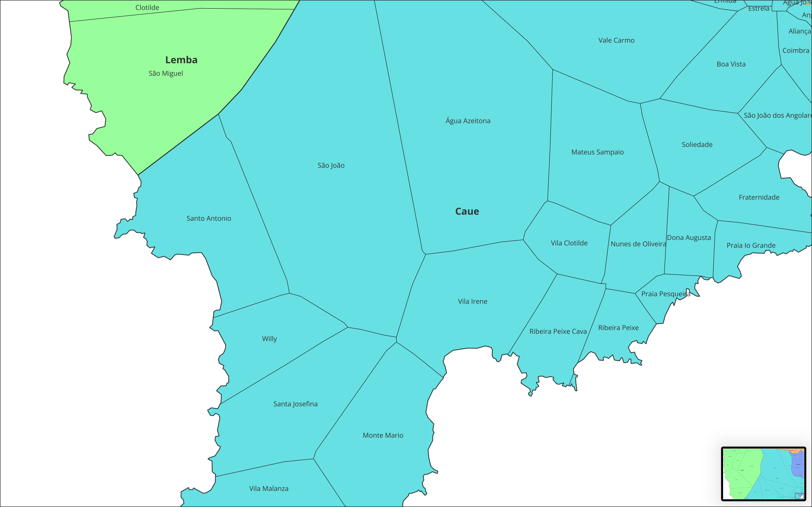

Slide 19
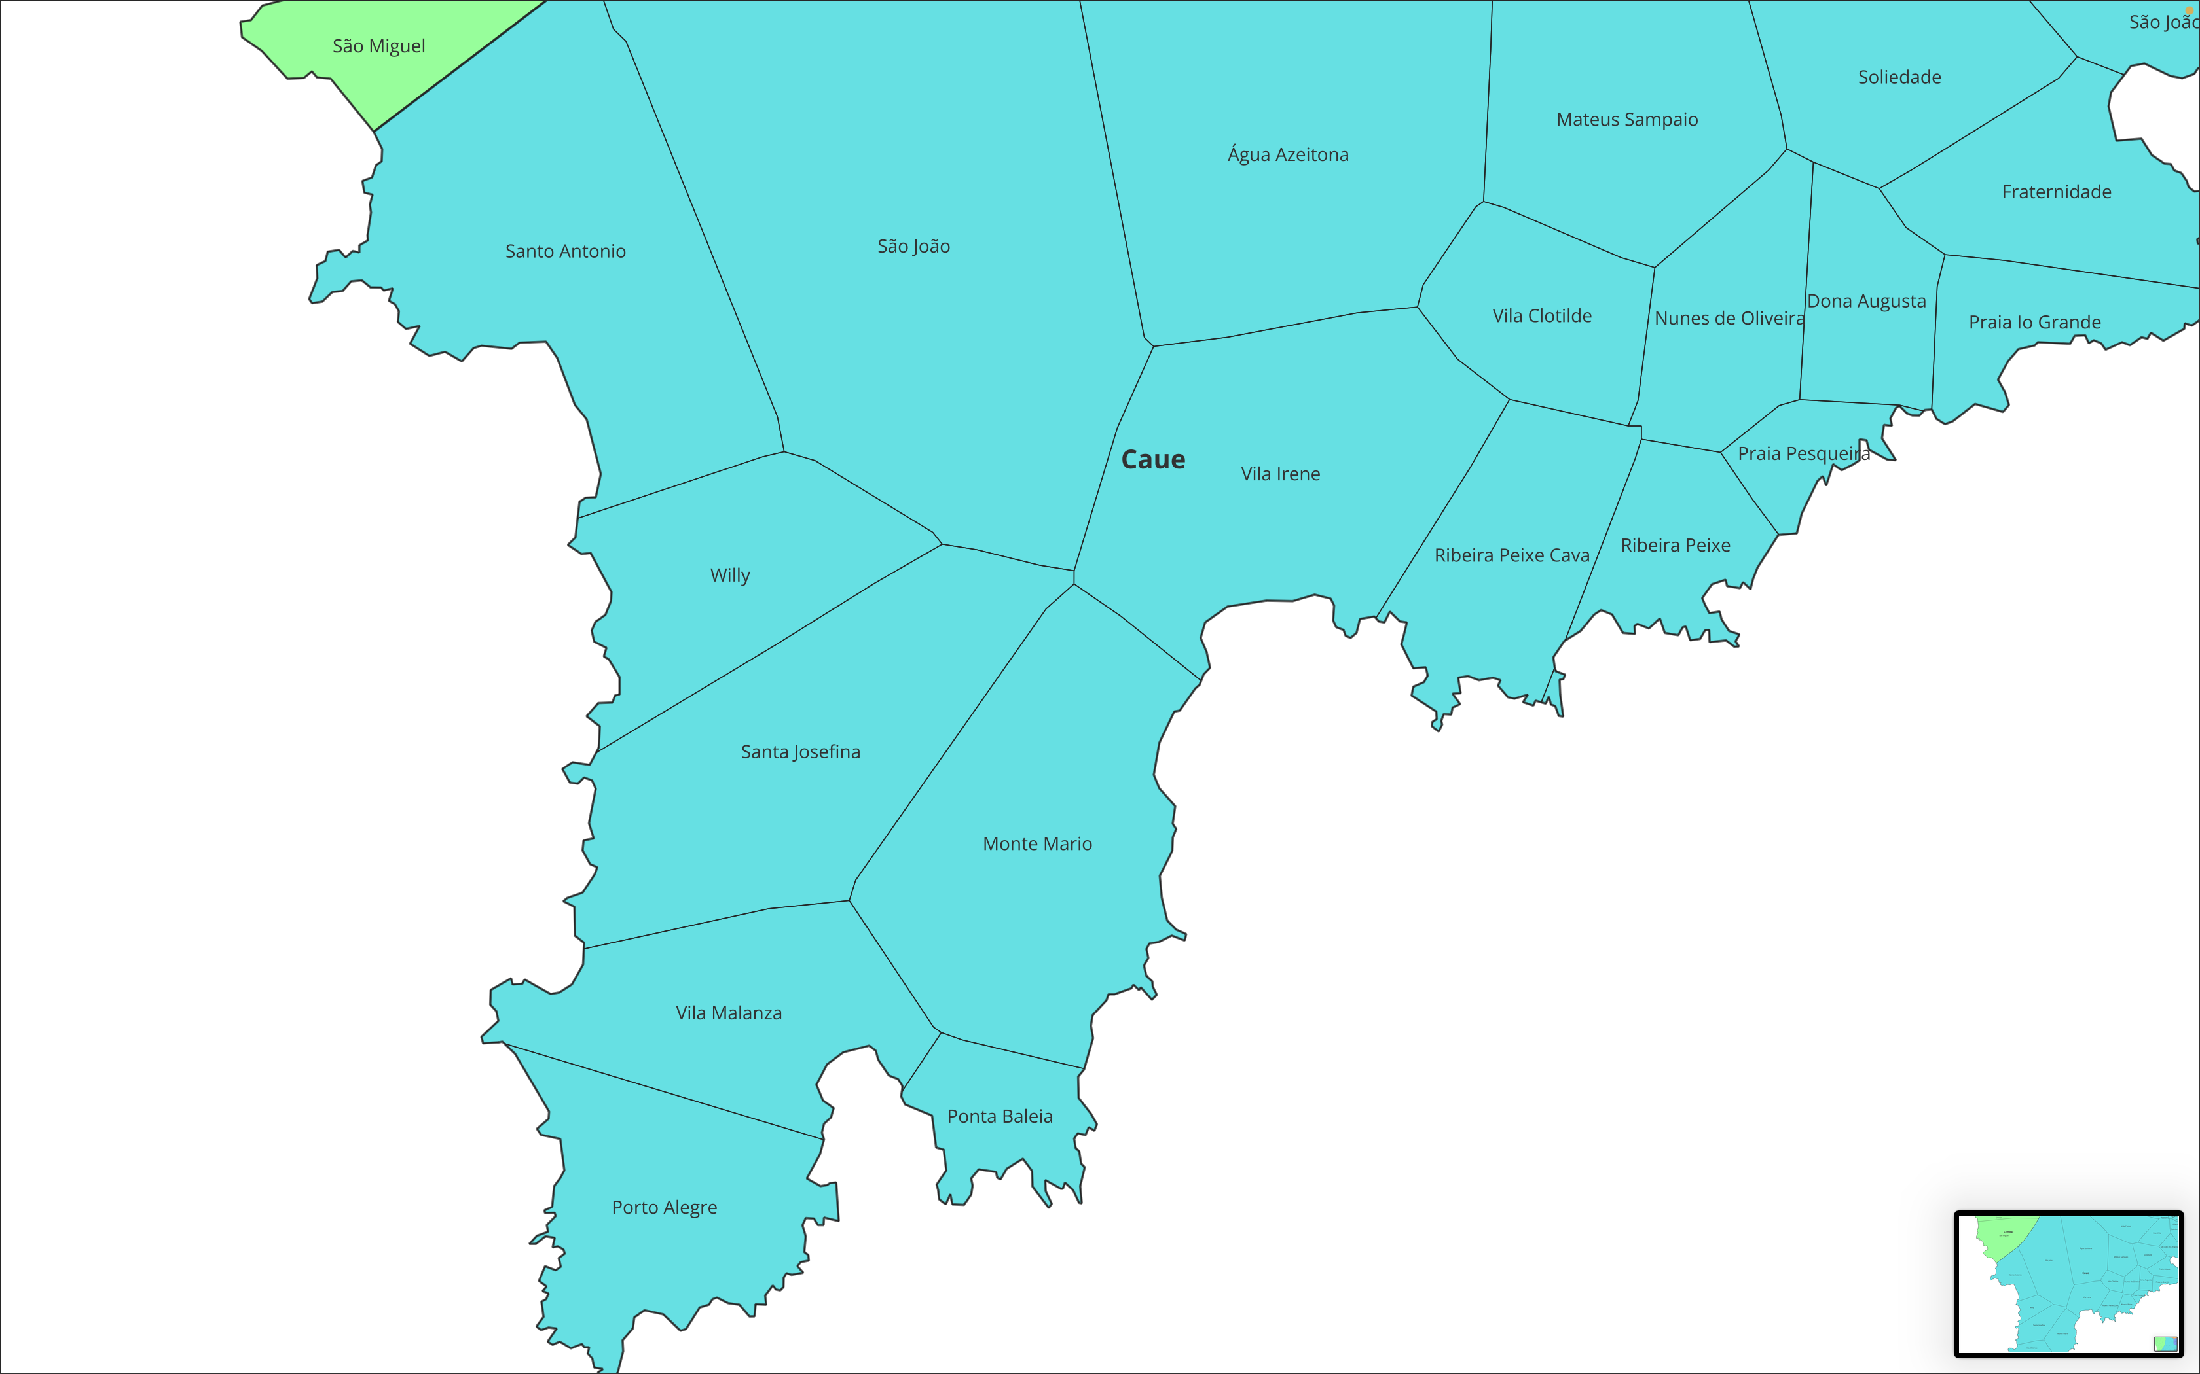

Slide 20
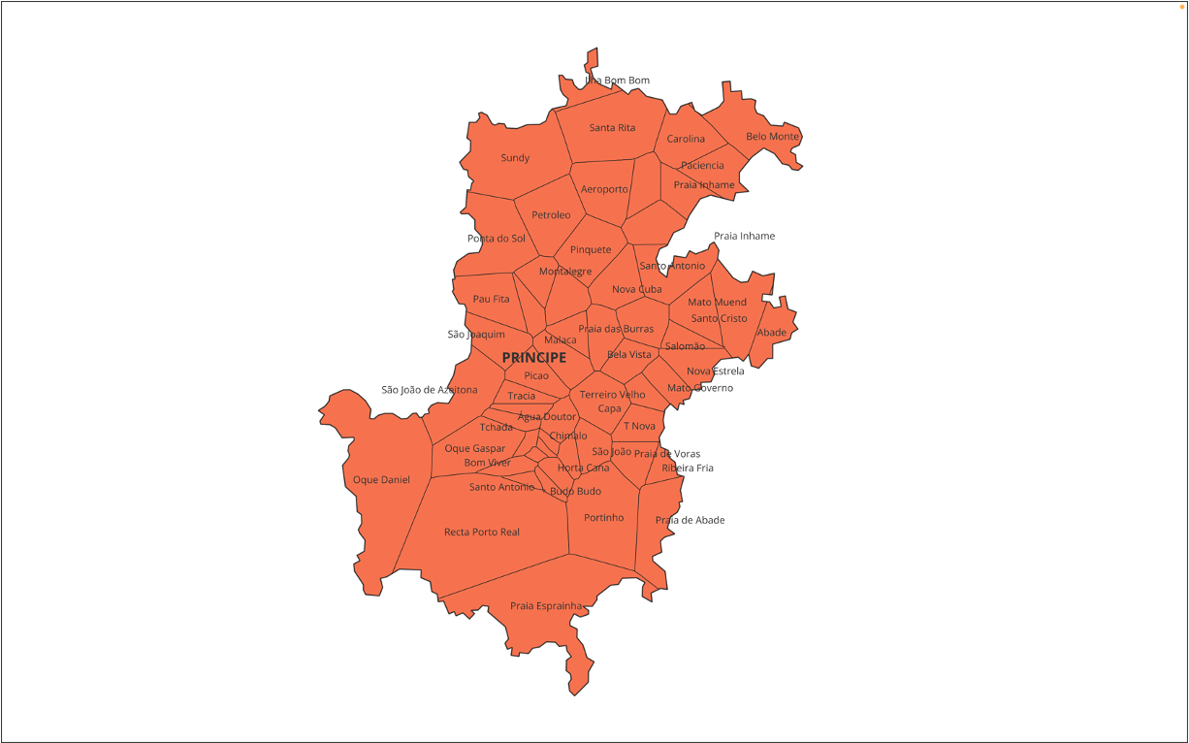

Slide 21
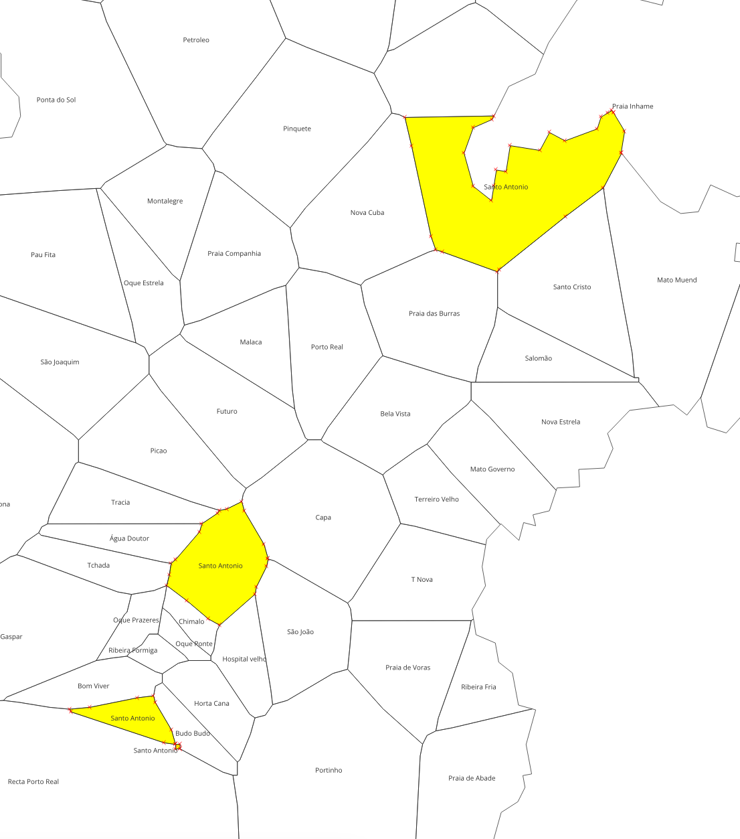
Shapefile data management
One more set of duplicates identified in the later analysis
Three Santo Antonio’s in Principe
requires confirmation

Slide 22
Administrative boundaries and distribution of Health Facilities: List of Duplicated Localities: 58
District | Localidide
Água Grande | Oque Mulundo
Água Grande | Oque Mulundo
Água Grande | Praia Francesa
Água Grande | Praia Francesa
Mé-Zochi | Água Mamblemble
Mé-Zochi | Água Mamblemble
Mé-Zochi | Almas
Mé-Zochi | Almas
Mé-Zochi | Benfica
Mé-Zochi | Benfica
Mé-Zochi | Benfica
Mé-Zochi | Bugue
Mé-Zochi | Bugue
Mé-Zochi | Malembê
Mé-Zochi | Malembê
Mé-Zochi | Pau Sabão
Mé-Zochi | Pau Sabão
Mé-Zochi | São José
Mé-Zochi | São José
Mé-Zochi | São José
Mé-Zochi | Santa Cruz
Mé-Zochi | Santa Cruz
District | Localidide
Cantagalo | Concon
Cantagalo | Concon
Cantagalo | Micondo
Cantagalo | Micondo
Cantagalo | Picao Flor
Cantagalo | Picao Flor
Cantagalo | Ribeira Afonso
Cantagalo | Ribeira Afonso
Cantagalo | Riboque Santana
Cantagalo | Riboque Santana
Caué | Aliança
Caué | Aliança
Caué | Porto Alegre
Caué | Porto Alegre
Lembá | Neves
Lembá | Neves
Lembá | Ribeira Palma Roça
Lembá | Ribeira Palma Roça
Lobata | Micoló
Lobata | Micoló
Lobata | Praia das Conchas
Lobata | Praia das Conchas
District | Localidide
Lobata | Bela Vista
Lobata | Bela Vista
Lobata | Gratidão
Lobata | Gratidão
Lobata | Izaquente Grande
Lobata | Izaquente Grande
Lobata | Maianço
Lobata | Maianço
Pagué | Oque Prazeres
Pagué | Oque Prazeres
Pagué | Santo Antonio
Pagué | Santo Antonio
Pagué | Santo Antonio
Pagué | Santo Antonio

Slide 23
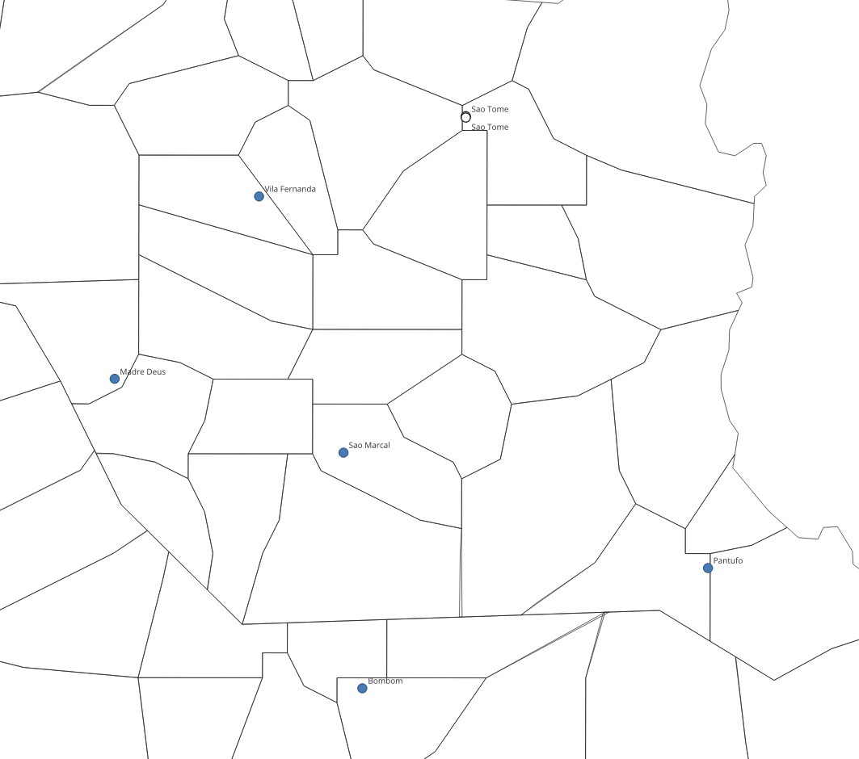
Health facility catchment areas
Creation of Health Facility catchment areas to estimate community-level incidence from HF-level data
Steps to generate HF catchment areas:
Calculate the Euclidian distance between each locality and all existing health facilities
Merge all localities that share the same nearest-by health facility
Feedback required from PNCM:
WHO sends a list for localities that belong to the same HF (see map on the right)
PNCM reviews list and provides feedback

Slide 24
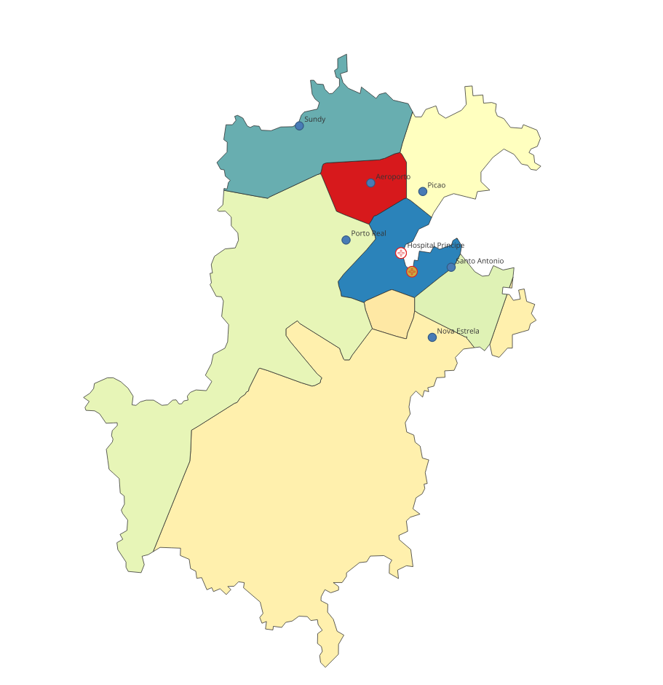
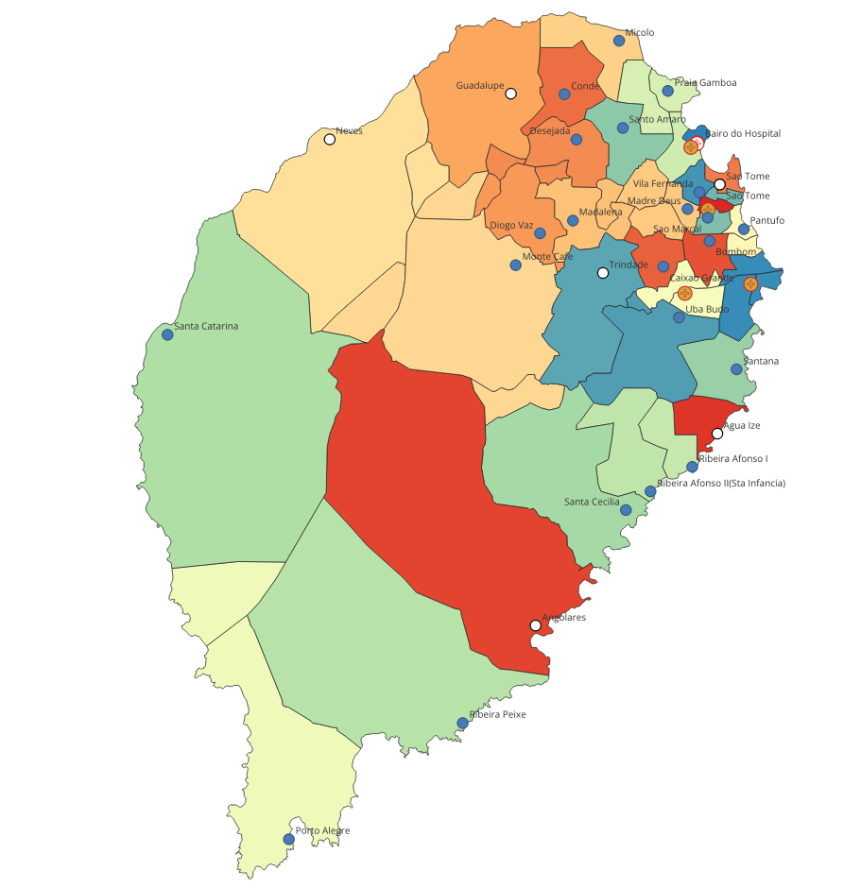
Health facility catchment areas
Creation of Health Facility catchment areas to estimate community-level incidence from HF-level data
Steps to generate HF catchment areas:
Calculate the Euclidian distance between each locality and all existing health facilities
Merge all localities that share the same nearest-by health facility
Feedback required from PNCM:
WHO sends a list for localities that belong to the same HF (see map on the right)
PNCM reviews list and provides feedback
Pending for feedback from PNCM

Slide 25
Provincial-level population estimates
Nome do distrito | Ano | População todas as idades | 0-4 | 5-9 | 10-14 | 15-19 | 20-24 | 25-29 | 30-34 | 35-39 | 40-44 | 45-49 | 50-54 | 55-59 | 60-64 | 65-69 | 70+
Me-Zochi | 2020 | Homens | 3,970 | 3,832 | 3,394 | 3,082 | 2,496 | 2,017 | 1,575 | 1,279 | 1,009 | 760 | 666 | 488 | 451 | 327 | 680
Me-Zochi | 2020 | Mulheres | 4,260 | 4,173 | 3,545 | 3,101 | 2,726 | 2,202 | 1,855 | 1,475 | 1,177 | 955 | 807 | 610 | 528 | 381 | 964
Me-Zochi | 2021 | Homens | 408 | 394 | 349 | 317 | 257 | 207 | 162 | 131 | 104 | 78 | 68 | 50 | 46 | 34 | 70
Me-Zochi | 2021 | Mulheres | 4,047 | 3,965 | 3,369 | 2,947 | 2,591 | 2,091 | 1,761 | 1,401 | 1,119 | 907 | 767 | 579 | 502 | 362 | 916
Me-Zochi | 2022 | Homens | 4,165 | 4,020 | 3,561 | 3,233 | 2,619 | 2,115 | 1,652 | 1,341 | 1,058 | 797 | 698 | 512 | 474 | 343 | 714
Me-Zochi | 2022 | Mulheres | 4,132 | 4,047 | 3,439 | 3,008 | 2,644 | 2,135 | 1,799 | 1,431 | 1,142 | 926 | 783 | 591 | 512 | 370 | 935
In 2021, the male population in Me-Zochi was noticeably lower compared to other years.
Feedback required from PNCM: Need to know where this was corrected
Fixed

Slide 27
Health Facilities
HFs without routine data
Agua Grande – HAM
Agua Grande - Serviço de saude reprodutivaSR
Mezochi – Uba Budo
Cantagalo - Uba Budo
Princepe – Posto SSR

Slide 29
Matching of localities with all databases
Databases with locality names that cannot be matched to the localities shapefile
shapefile_data_management_STP.xlsx

